Slide 1
Chain Mail - Plate
Distributed Localization and Hardware-in-the-Loop Validation
Derek Chen
Scrimmage
10
Chain Mail
1
Chain Mail is for quickly determining satellite position, addressing a major challenge for operators of proliferated LEO constellations.
The Plate Mail scrimmage team tackles this challenge by designing a distributed architecture for cooperative localization based on a distributed Kalman filter (KF) and validated on hardware-in-the-loop (HIL) simulation.
As more and more pLEO constellations are deployed, satellite operations are becoming increasingly difficult as ground operations systems may become overwhelmed by the influx of data. To alleviate this, the Plate Mail design enables satellite constellations to perform their own orbit determination.
By the end of the first sprint, we seek to build a prototype implementing the Plate Mail architecture. First, we will adapt the distributed KF for distributed spacecraft orbit estimation and demonstrate that each SV node estimate its position and velocity based off of ranging measurements to its neighbors. We will then integrate ground-system aiding to anchor the constellation nodes and reduce error. Next, as a proof-of-concept, we will prototype our distributed approach running a HIL orbit simulation with multiple networked nodes running on microprocessor nodes (e.g. RPi). Each node will have the capability of networking into the simulation for measurements and performing their own OD.

Slide 2
Chain Mail - Plate
Distributed Localization and Hardware-in-the-Loop Validation
Derek Chen
As space becomes more accessible, the influx pLEO constellations and satellites are quickly starting to overwhelm satellite tracking ground systems. For rapid and reliable operation of our own deployed constellations, the constellations will have to participate in helping operators gain Space Situational Awareness (SSA) by actively estimating their state (position and velocity).
As in all relative estimation problems, inter-node ranging may only estimate the position of each node in respect to the other nodes. To anchor the constellation to the Earth-centered frame, Plate Mail uses ground system aiding to disseminate anchoring measurement “information” in the form of reduced measurement uncertainty.
We are requesting $1k in capital to purchase hardware necessary for an embedded hardware-in-the-loop proof-of-concept. Our embedded system will demonstrate a networked hardware-in-the-loop simulation scenario. The central server will provide the orbit propagation truth and measurements for each node. Each node will request simulated ranging measurements to nearby nodes from the central server and estimate position and velocity. This will simulate operation on a SWaP-constrained platform with low processing and transmission data rates.
After implementing the Plate Mail architecture and embedded simulation infrastructure, next steps for the project will investigate:
Range measurements – Optical vs. RF will affect SWaP and measurement availability
Measurement Prioritization – In distributed constellation, a few nodes will have a more confident state estimate (due to geometry, ground-aiding, less interference). How do we prioritize measurements from these.
Network messaging – Network messaging comes into play when each node needs not just the range, but also an estimate of neighboring nodes’ states. How do we isolate the optimal neighbors from numerous broadcasting nodes

Slide 3
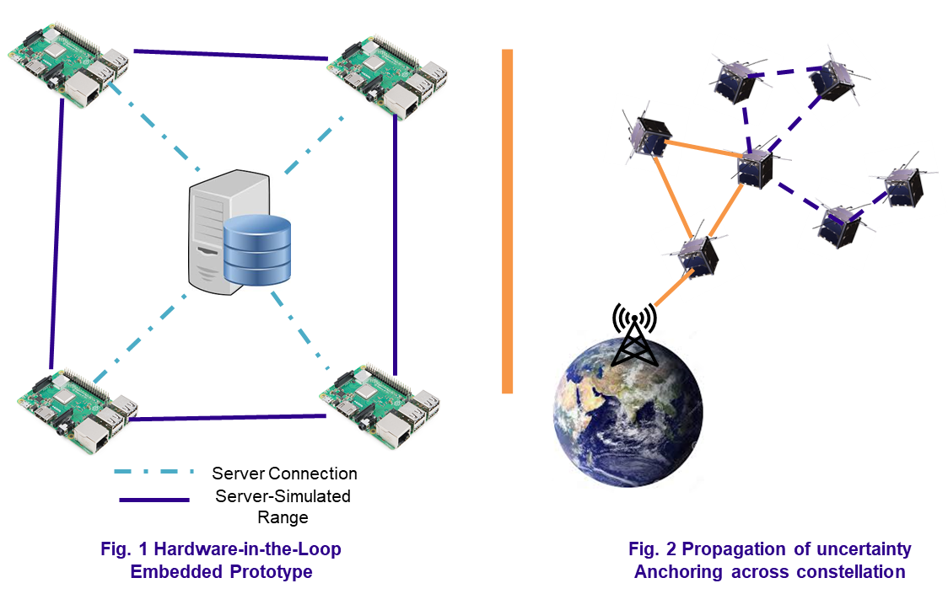
Chain Mail - Plate
Distributed Localization and Hardware-in-the-Loop Validation
Derek Chen
Fig. 1 shows the Hardware-in-the-Loop embedded implementation of how we will validate the Plate Mail estimation architecture.
Fig. 2 shows how ground-system aiding will be able to anchor the estimation uncertainty. Ranging measurements serve as disseminating medium, reducing the uncertainty of the constellation state estimate as a whole.

Slide 4
Chain Mail - Plate
Distributed Localization and Hardware-in-the-Loop Validation
Derek Chen
Demonstrate using embedded hardware running a networked simulation that satellites can perform relative positioning
Demonstrate state estimation capabilities in scenarios with dynamic networking constraints by integrating embedded hardware with dynamic platforms (UAVs, robots)
Demonstrate on-orbit orbit determination through a cluster of deployed smallsats. Validate with ground tracking measurements.
Interest in pLEO constellations have positioned space to be on the verge of a massive influx of smallsats
Satellites are crosslinked
Spoon modularity allows integration of Plate Mail across numerous smallsats
Slingshot for on-orbit demonstrations

